Slide 1
ZigZag-Project: Enabling Fast Architecture-Mapping DSE for Deep Learning Accelerators
ISPASS2023 Tutorial
Arne Symons, Linyan Mei, Guilherme Paim
Prof. Marian Verhelst
MICAS Labs, ESAT, KU Leuven, Belgium

Slide 2
Tutorial Outline
Introduction (8:30 – 8:50)
Lab 1: Assess HW performance of DNN layer onto accelerator, with fixed temporal mapping (8:50 – 9:30)
Lab 2: Automate temporal mapping optimization (9:30 – 10:00)
Break (10:00 – 10:30)
Lab 3: Understand the HW architecture definition (10:30 – 11:00)
Lab 4: Explore layer-fused mappings on multi-core architectures using Stream (11:00 – 11:45)
Concluding remarks (11:45 – 12:00)

Slide 3
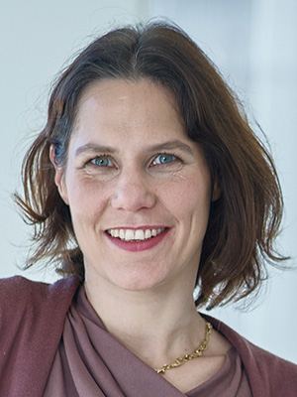
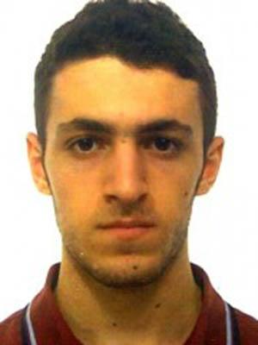
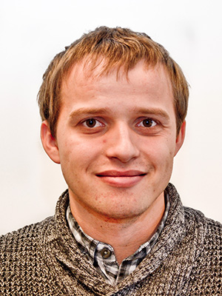
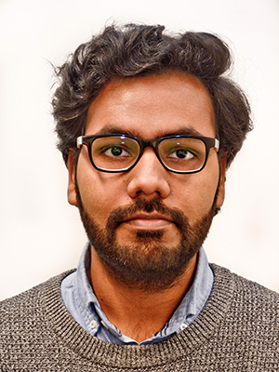
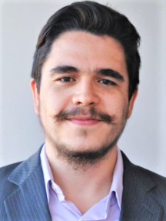
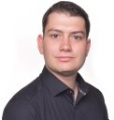
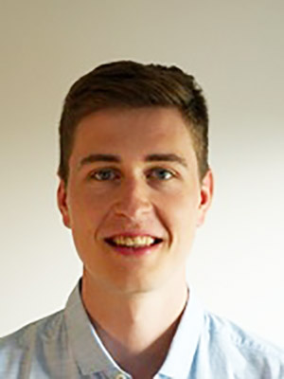
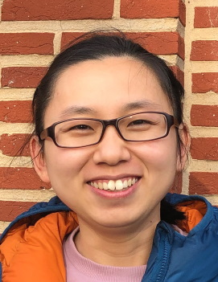
ZigZag Project
Project started Dec. 2018
Many contributors
Prof. Marian Verhelst
Pouya Houshmand
Steven Colleman
Vikram Jain
Guilherme Paim
Koen Goetschalckx
Arne Symons
Linyan Mei
Victor JUNG (ETHz)
Sebastian Karl (TUM)

Slide 4
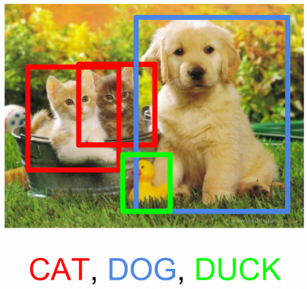
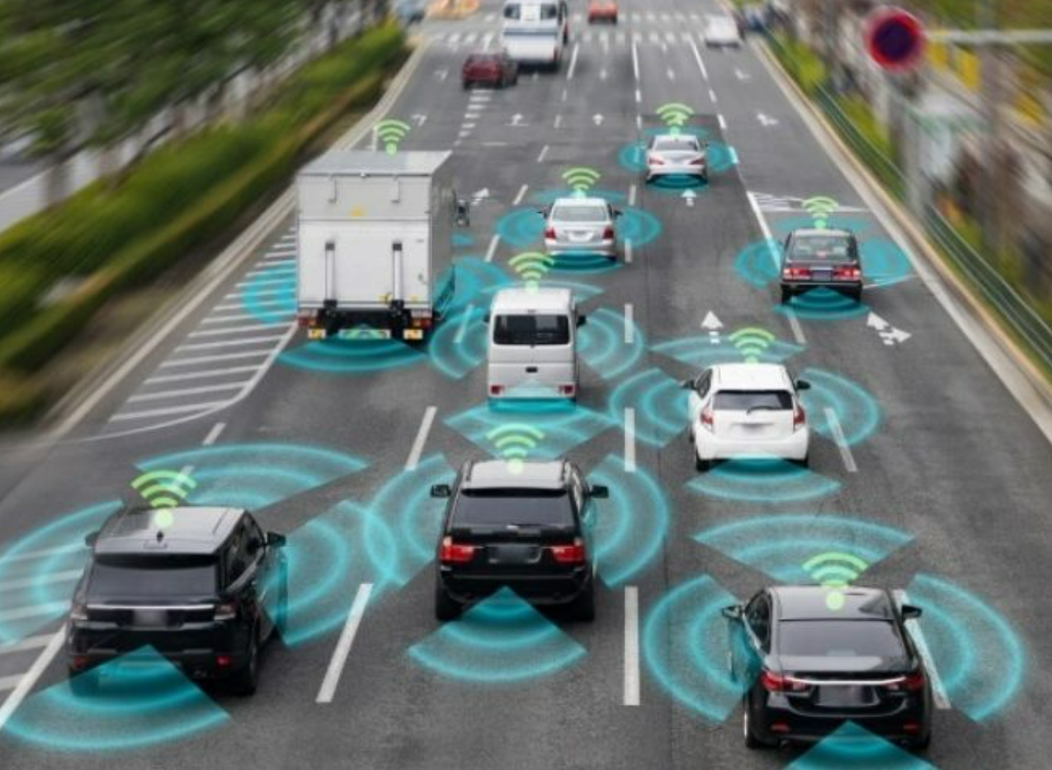
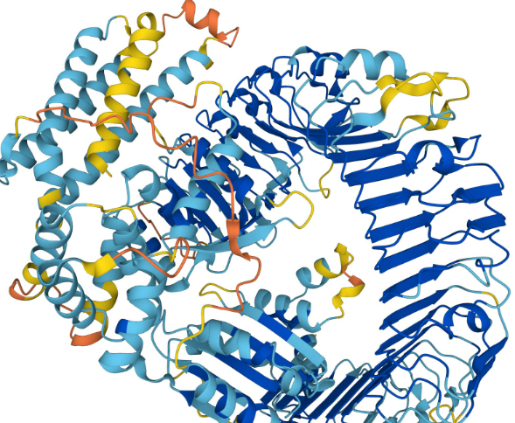
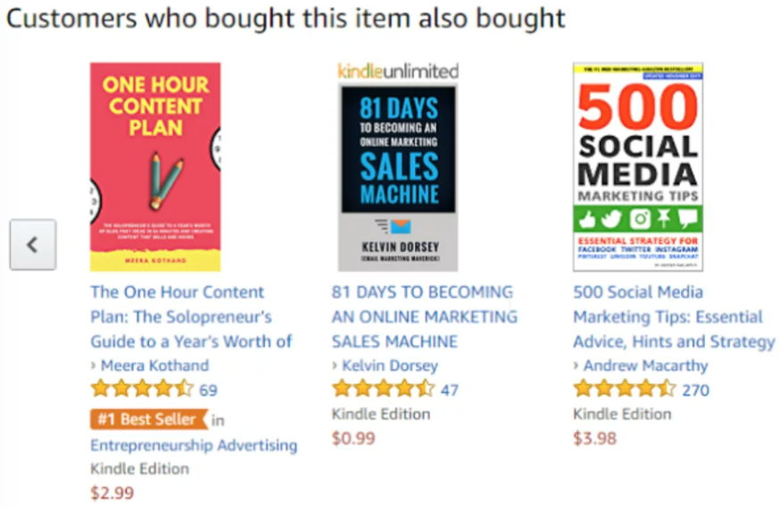
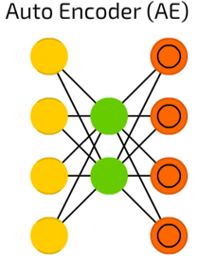
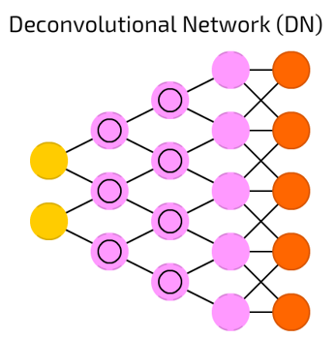
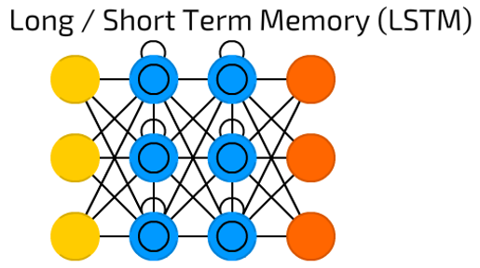
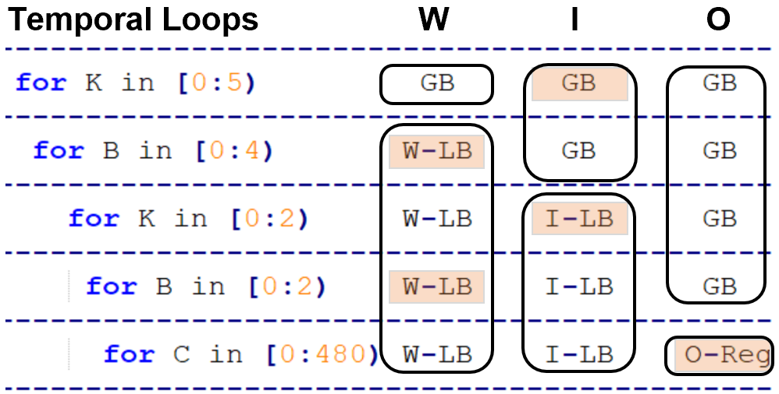
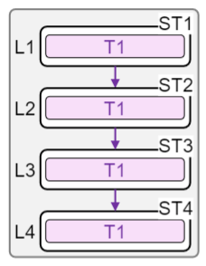
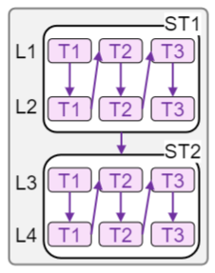
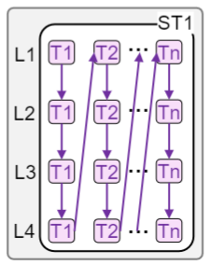
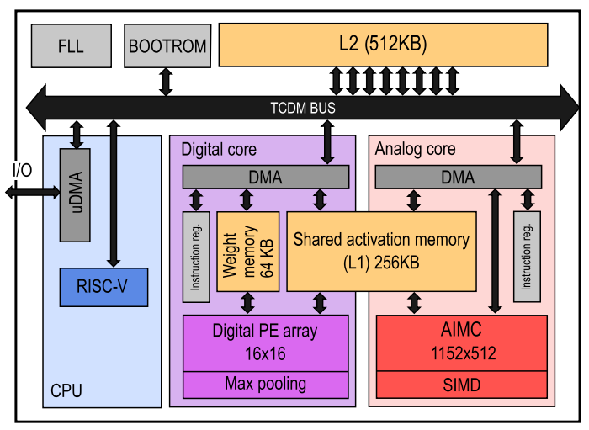
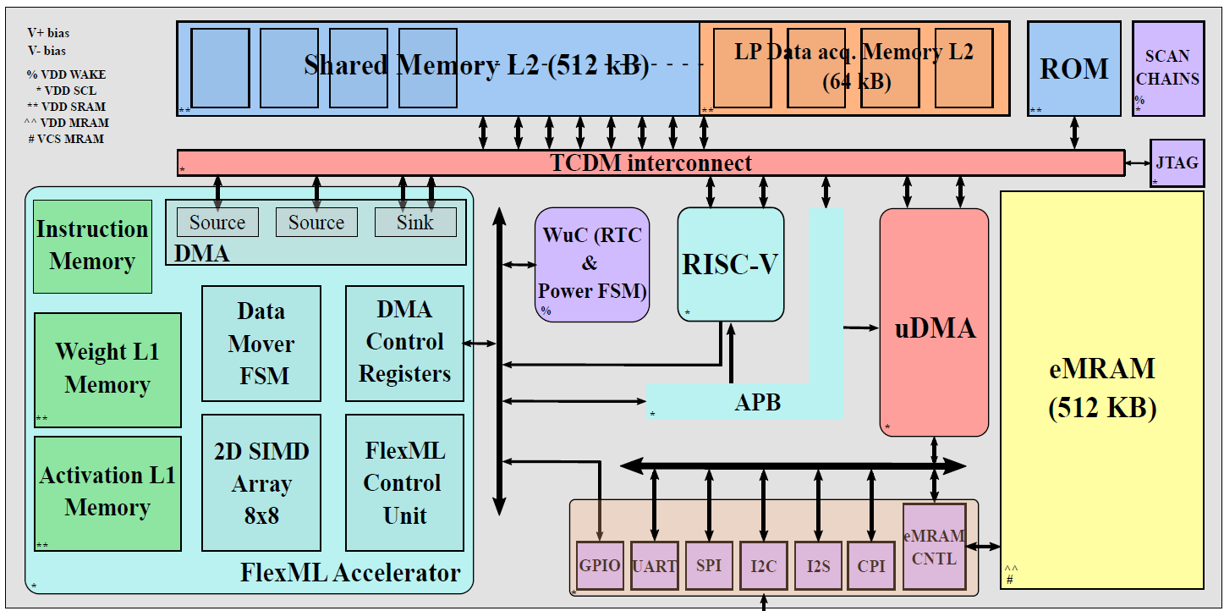
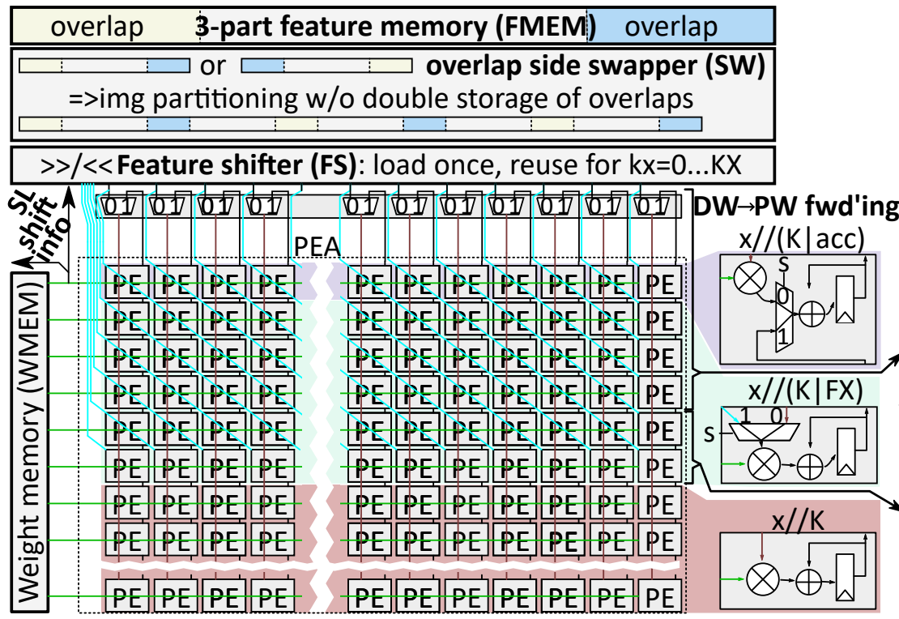
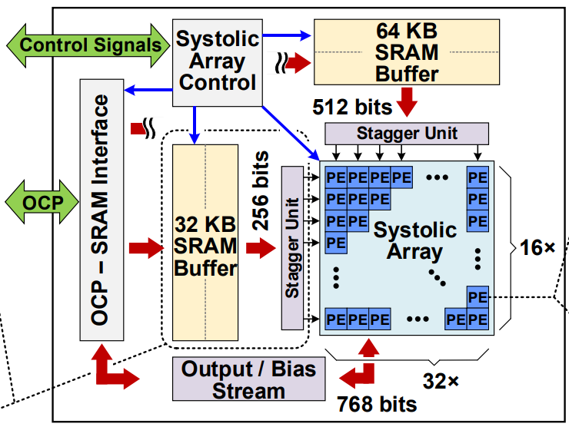
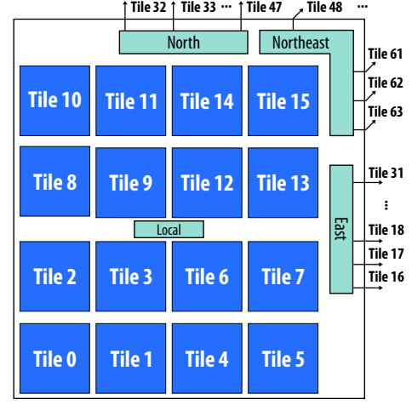
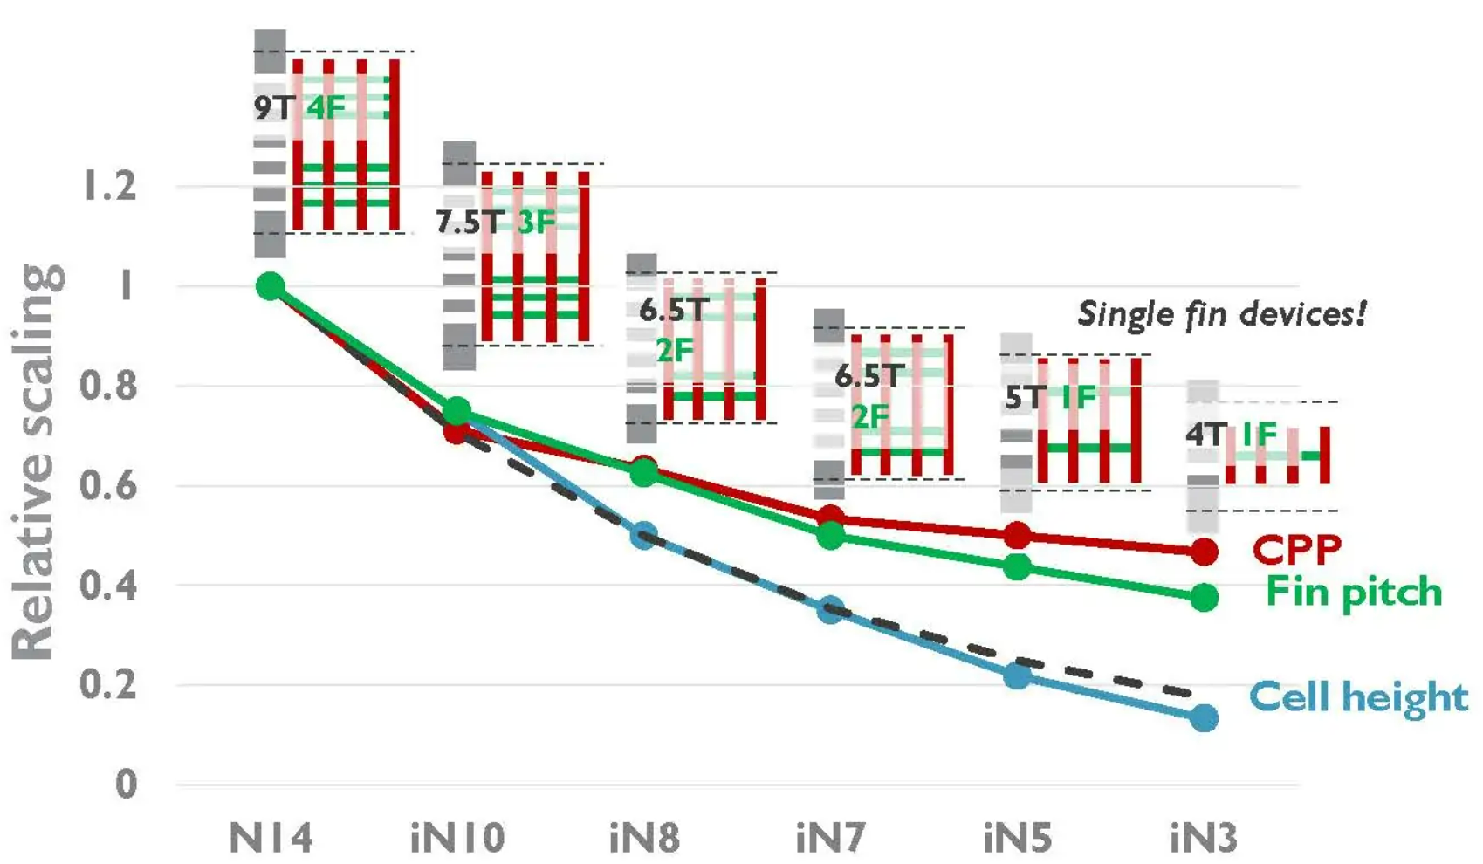
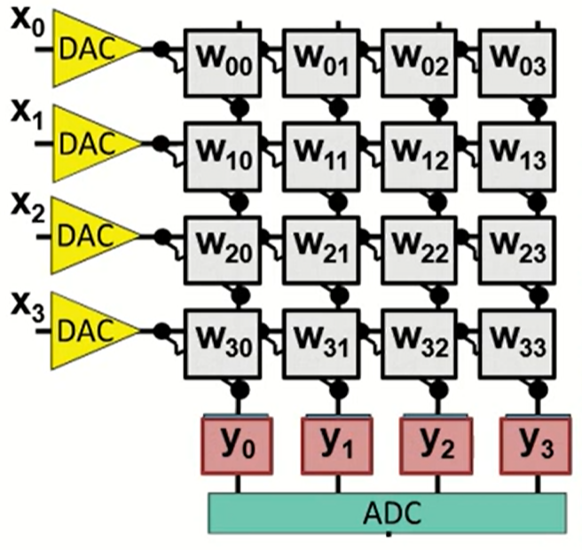
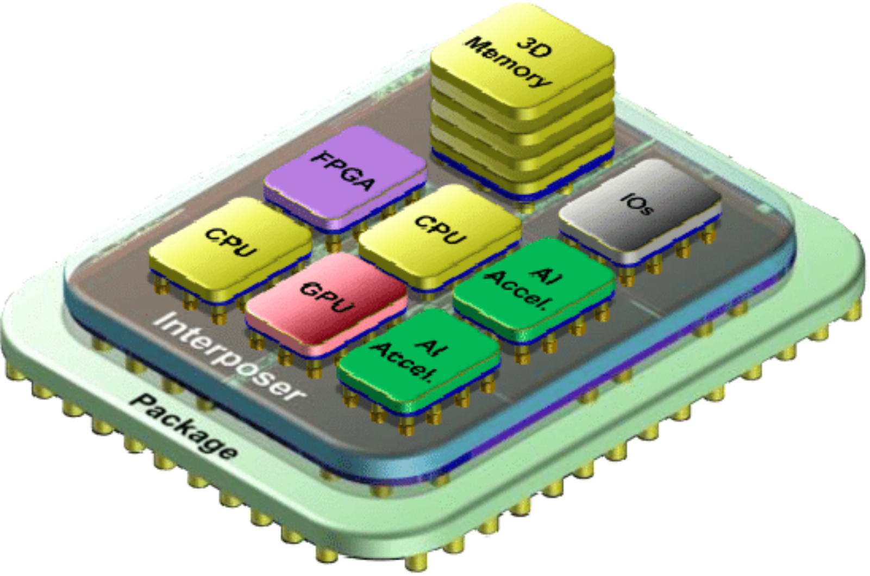
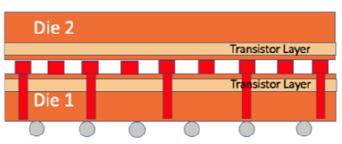
A high-level view
Application
Algorithm
ZigZag-project
Mapping/
Scheduling
HW Arch.
Technology

Slide 5
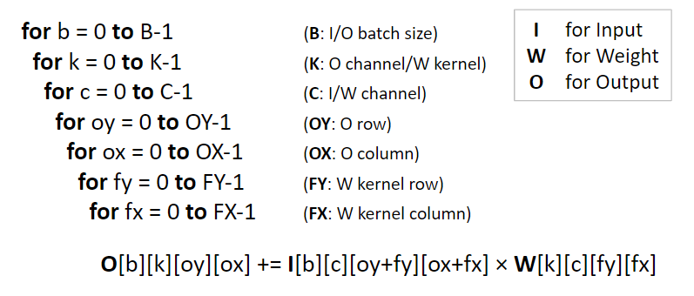
DNN Layer
A DNN Conv2D layer:
3D operand (W/I/O) space.
7D nested for-loop MAC operation.
Each Operand has its own (ir)relevant loop dimensions.
r loops contribute to data size.
ir loops contribute to data reuse.
pr loops contribute to both
data size and data reuse.

Slide 6
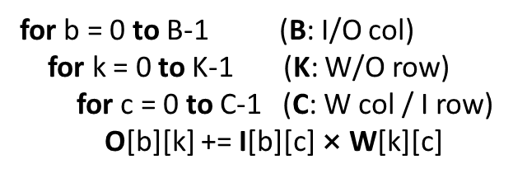
DNN Layer
Conv2D
MMM
Most ML workloads fit into the regular nested for-loop format.
No data dependency between each for-loop.

Slide 7
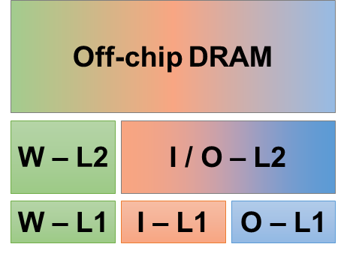
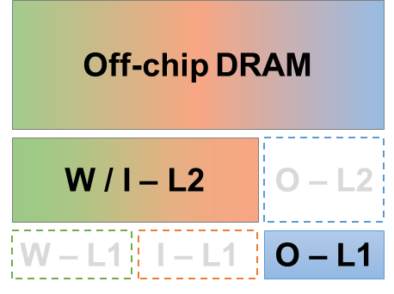
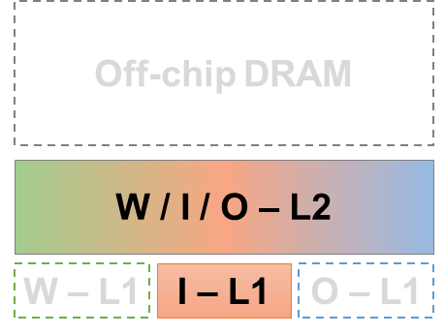
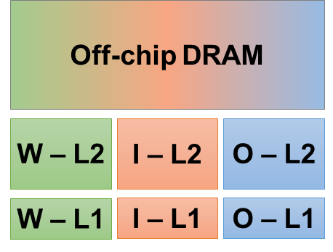
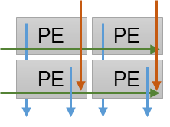
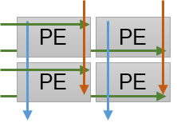
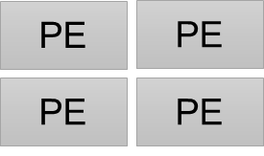
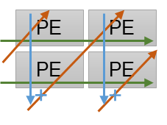
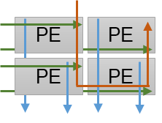
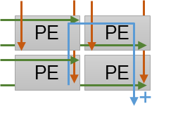
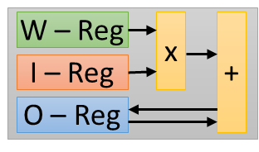
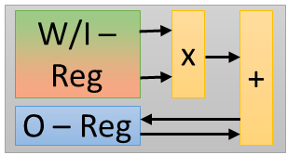
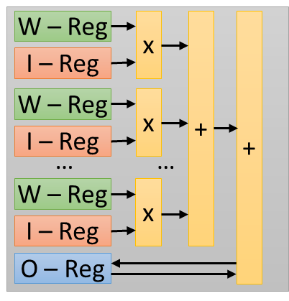
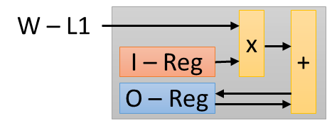
DNN Accelerator
Off-chip DRAM
Memory Hierarchy
W – L2
I – L2
O – L2
…
PE Array & Interconnects
W – L1
I – L1
O – L1
PE
PE
PE
PE
W
I
O
…
PE
PE
PE
PE
PE
PE
PE
PE
PE Design
PE
PE
PE
PE
PE
Large Design Degrees of Freedom!
…

Slide 8
Mapping (a.k.a. Dataflow)
Temporal Mapping
(Loop tilling, ordering)
Off-chip DRAM
Data Stationarity
W – L2
I – L2
O – L2
W – L1
I – L1
O – L1
PE
PE
PE
PE
MAC
W – Reg
PE
PE
PE
PE
I – Reg
O – Reg
Operation Parallelism
PE
PE
PE
PE
PE
PE
PE
PE
Spatial Mapping
(Loop unrolling)
Large Design Degrees of Freedom!

Slide 9
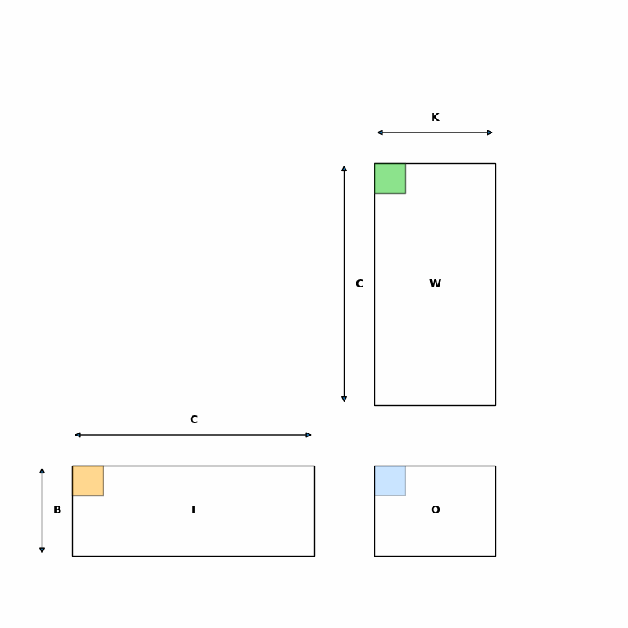
Loop Ordering and Splitting
K=4
W
C=8
K=4
for b in [0: 3):
for k in [0: 4):
for c in [0: 8):
O[b][k] = I[b][c] × W[k][c]
B=3
I
×
=
O
B=3
C=8
for k₂ in [0: 2):
for c in [0: 8):
for b in [0: 3):
for k₁ in [0: 2):
O[b][2k₂+k₁] = I[b][c] × W[2k₂+k₁][c]
for b in [0: 3):
for k in [0: 4):
for c in [0: 8):
O[b][k] = I[b][c] × W[k][c]
for b in [0: 3):
for c in [0: 8):
for k in [0: 4):
O[b][k] = I[b][c] × W[k][c]
for k in [0: 4):
for c in [0: 8):
for b in [0: 3):
O[b][k] = I[b][c] × W[k][c]

Slide 10
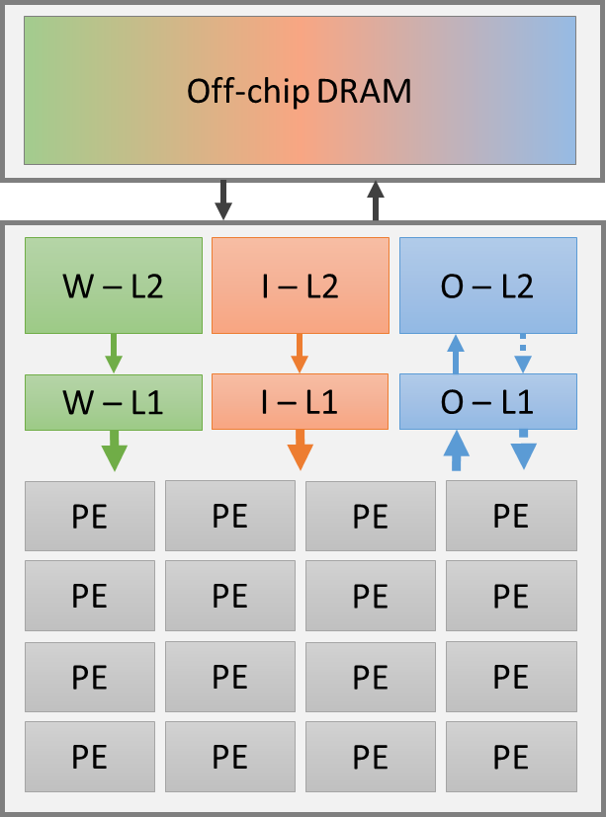
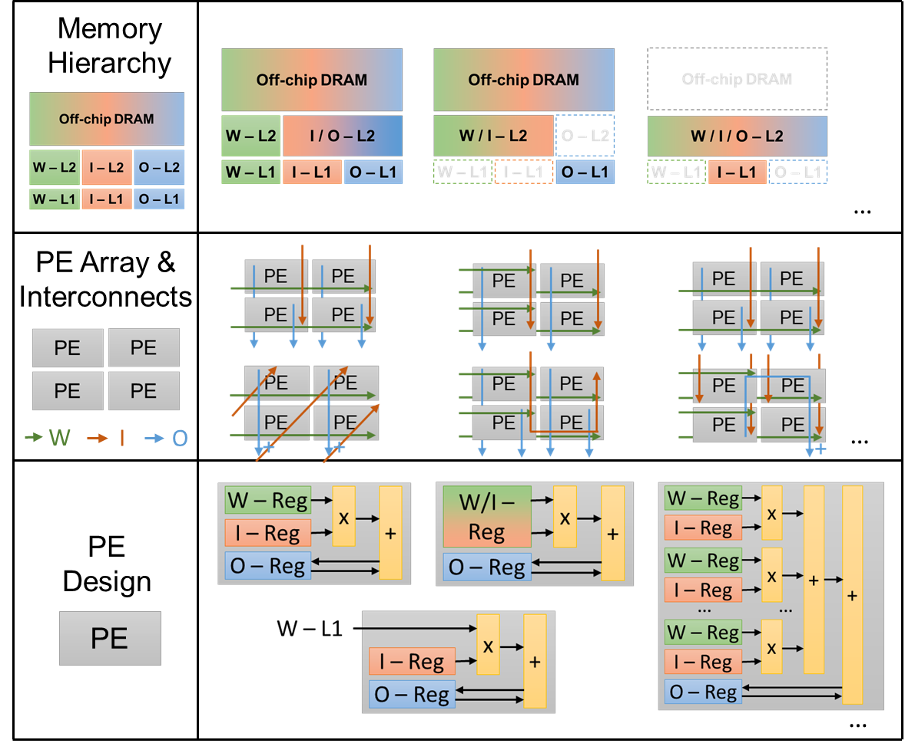
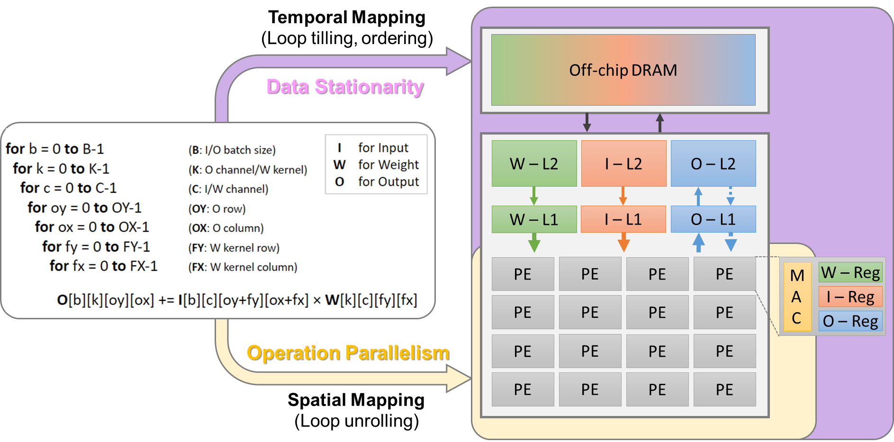
Co-Exploration
Algorithm
Hardware
Mapping
Technology and Others
Technology: 65nm/40nm/28nm/…,
NVM, CIM, 3D IC, etc.
Others: Sparsity, various precisions, cross-layer execution, etc.
HUGE design space at each level & at combined levels.
Regular workload & Deterministic processing flow & Well-defined HW components.

Slide 11
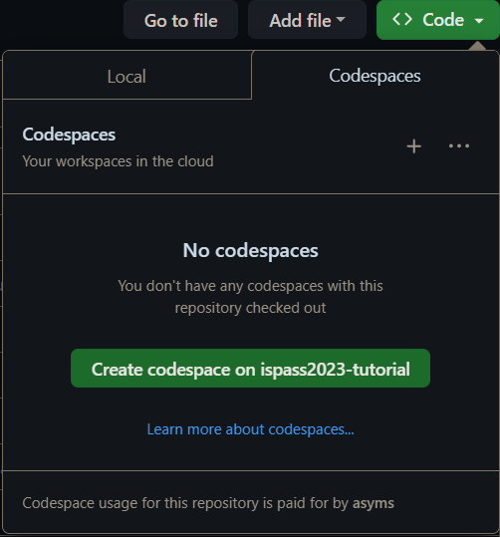
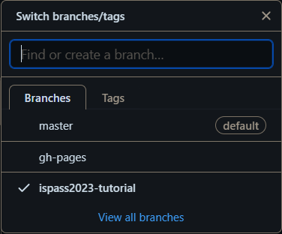
Getting Started: Codespaces
https://github.com/ZigZag-Project/zigzag
Select ispass2023-tutorial
Create codespace

Slide 12
Getting Started: Manual Clone
https://github.com/ZigZag-Project/zigzag
$ git clone git@github.com:ZigZag-Project/zigzag.git
$ cd zigzag
$ conda create --name my-zigzag-env python=3.10
$ conda activate my-zigzag-env
$ pip install –r requirements.txt
$ git checkout ispass2023-tutorial
$ code .

Slide 13
Lab 1: ZigZag Cost Model
Open lab1/main.py
Expects three arguments:
accelerator
model
mapping
Extracts names from the given arguments and sets inputs
Defines the sequence of stages to be executed
Runs the sequence of stages with inputs
Plots the returned CostModelEvaluation (CME)

Slide 14
Lab 1: ZigZag Cost Model
Model (workload)
First layer of ResNet18 (ONNX format)

Slide 15
Lab 1: ZigZag Cost Model
Accelerator
TPU-like architecture
DRAM
(I1/I2/O)
D1 : 32
I2
MAC
I2
MAC
I2
MAC
I2
MAC
Global Buffer
(I1/O)
I2
MAC
I2
MAC
I2
MAC
I2
MAC
.....
D2 : 32
I2
MAC
I2
MAC
I2
MAC
.....
I2
MAC
I2
MAC
I2
MAC
I2
MAC
O
O
O
O

Slide 16
Lab 1: ZigZag Cost Model
Mapping
Defines mapping of layers onto accelerator

Slide 17
Lab 1: ZigZag Cost Model
DRAM
(I1/I2/O)
D1 : 32
Unroll K
I2
MAC
I2
MAC
I2
MAC
I2
MAC
Global Buffer
(I1/O)
I2
MAC
I2
MAC
I2
MAC
I2
MAC
D2 : 32
.....
Unroll C
I2
MAC
I2
MAC
I2
MAC
.....
I2
MAC
I2
MAC
I2
MAC
I2
MAC
O
O
O
O

Slide 18
Lab 1: ZigZag Cost Model
Mapping
Defines mapping of layers onto accelerator

Slide 19
Lab 1: ZigZag Cost Model
I1 → I I2 → W O → O
DRAM
(I/W/O)
D1 : 32
Unroll K
W
MAC
W
MAC
W
MAC
W
MAC
Global Buffer
(I/O)
W
MAC
W
MAC
W
MAC
W
MAC
D2 : 32
.....
Unroll C
W
MAC
W
MAC
W
MAC
.....
W
MAC
W
MAC
W
MAC
W
MAC
O
O
O
O

Slide 20
Lab 1: ZigZag Cost Model
First experiment:
model = “lab1/resnet18_first_layer.onnx”
accelerator = “zigzag.inputs.examples.hardware.TPU_like”
mapping = “mapping”
Run lab1/main.py

Slide 21
Lab 1: ZigZag Cost Model
Second experiment:
Modify lab1/mapping.py:
Change temporal loop ordering
Run lab1/main.py

Slide 22
Lab 2: Automating temporal mapping
Copy lab1/main.py → lab2/main.py
Replace TemporalOrderingConversionStage → LomaStage
Change dump_filename_pattern
Change plotting save_path
Copy lab1/mapping.py → lab2/mapping.py
Remove temporal_ordering

Slide 23
Lab 2: Automating temporal mapping
First experiment:
model = “lab2/resnet18_first_layer.onnx”
accelerator = “zigzag.inputs.examples.hardware.TPU_like”
mapping = “mapping”
Run lab2/main.py

Slide 24
Lab 2: User-defined workload
Copy lab2/main.py → lab2/main_user_defined.py
Replace ONNXModelParserStage→ WorkloadParserStage
Change dump_filename_pattern
Change plotting save_path

Slide 25
Lab 2: User-defined workload
Second experiment:
model = “resnet18_first_layer”
accelerator = “zigzag.inputs.examples.hardware.TPU_like”
mapping = “mapping”
Run lab2/main_user_defined.py

Slide 26
Intermezzo: API
ZigZag is also distributed on PyPI
API call for common use-case

Slide 27
Break
Lab 3 & 4 after the break
Start at 10.30 AM

Slide 28
Lab 3: Architectural impact
Open lab3/inputs/hardware/c_k.py
Definition of multiplier array
Definition of memory hierarchy
Definition of core

Slide 29
Lab 3: c_k.py
memory_instances
dram
rf_1B
l1_io
l2_io
l1_w
rf_4B
l2_w

Slide 30
Lab 3: c_k.py
multiplier_array
D1 : 32
MAC
MAC
MAC
MAC
MAC
MAC
MAC
MAC
.....
D2 : 32
MAC
MAC
MAC
.....
MAC
MAC
MAC
MAC

Slide 31
Lab 3: c_k.py
multiplier_array
rf_1B
D1 : 32
I2
MAC
I2
MAC
I2
MAC
I2
MAC
I2
MAC
I2
MAC
I2
MAC
I2
MAC
.....
D2 : 32
I2
MAC
I2
MAC
I2
MAC
.....
I2
MAC
I2
MAC
I2
MAC
I2
MAC

Slide 32
Lab 3: c_k.py
multiplier_array
rf_1B
rf_1B
D1 : 32
I1
I2
MAC
I2
MAC
I2
MAC
I2
MAC
I1
I2
MAC
I2
MAC
I2
MAC
I2
MAC
D2 : 32
I2
MAC
I2
MAC
...
I2
MAC
I1
.....
I1
I2
MAC
I2
MAC
I2
MAC
I2
MAC

Slide 33
Lab 3: c_k.py
multiplier_array
rf_1B
rf_1B
rf_4B
D1 : 32
I1
I2
MAC
I2
MAC
I2
MAC
I2
MAC
I1
I2
MAC
I2
MAC
I2
MAC
I2
MAC
D2 : 32
I2
MAC
I2
MAC
...
I2
MAC
I1
.....
I1
I2
MAC
I2
MAC
I2
MAC
I2
MAC
O
O
O
O

Slide 34
Lab 3: c_k.py
multiplier_array
rf_1B
rf_1B
rf_4B
l1_w
I2
I1
I2
MAC
I2
MAC
I2
MAC
I2
MAC
I1
I2
MAC
I2
MAC
I2
MAC
I2
MAC
I2
MAC
I2
MAC
...
I2
MAC
I1
.....
I1
I2
MAC
I2
MAC
I2
MAC
I2
MAC
O
O
O
O

Slide 35
Lab 3: c_k.py
multiplier_array
rf_1B
rf_1B
rf_4B
l1_w
l1_io
I2
I1/O
I2
MAC
I2
MAC
I2
MAC
I2
MAC
I1
I1
I2
MAC
I2
MAC
I2
MAC
I2
MAC
I2
MAC
I2
MAC
...
I2
MAC
I1
.....
I1
I2
MAC
I2
MAC
I2
MAC
I2
MAC
O
O
O
O

Slide 36
Lab 3: c_k.py
I2
multiplier_array
rf_1B
rf_1B
rf_4B
l1_w
l1_io
l2_w
I2
I1/O
I2
MAC
I2
MAC
I2
MAC
I2
MAC
I1
I1
I2
MAC
I2
MAC
I2
MAC
I2
MAC
I2
MAC
I2
MAC
...
I2
MAC
I1
.....
I1
I2
MAC
I2
MAC
I2
MAC
I2
MAC
O
O
O
O

Slide 37
Lab 3: c_k.py
I2
multiplier_array
rf_1B
rf_1B
rf_4B
l1_w
l1_io
l2_w
l2_io
I2
I1/O
I1/O
I2
MAC
I2
MAC
I2
MAC
I2
MAC
I1
I1
I2
MAC
I2
MAC
I2
MAC
I2
MAC
I2
MAC
I2
MAC
...
I2
MAC
I1
.....
I1
I2
MAC
I2
MAC
I2
MAC
I2
MAC
O
O
O
O

Slide 38
Lab 3: c_k.py
I1/
I2/
O
I2
multiplier_array
rf_1B
rf_1B
rf_4B
l1_w
l1_io
l2_w
l2_io
dram
I2
I1/O
I1/O
I2
MAC
I2
MAC
I2
MAC
I2
MAC
I1
I1
I2
MAC
I2
MAC
I2
MAC
I2
MAC
I2
MAC
I2
MAC
...
I2
MAC
I1
.....
I1
I2
MAC
I2
MAC
I2
MAC
I2
MAC
O
O
O
O

Slide 39
Lab 3: Architectural impact
Open lab3/inputs/hardware/c_k.py
Definition of multiplier array
Definition of memory hierarchy
Definition of core
Open lab3/inputs/mapping/…
Definition of spatial mappings

Slide 40
Lab 3: Architectural impact
Open lab3/inputs/hardware/c_k.py
Definition of multiplier array
Definition of memory hierarchy
Definition of core
Open lab3/inputs/mapping/…
Definition of spatial mappings
Open lab3/main.py
Uses API call for every core architecture mapping
Uses API call for architecture comparison plot

Slide 41
Lab 3: Architectural impact
First experiment:
Run lab3/main.py

Slide 42
Conclusion: ZigZag
Hardware accelerator model based on array of multipliers and attached memory hierarchy
Hardware performance estimation of DNN layer through analytical cost model
Optimization of layer mapping through different stages
Enables co-exploration of accelerator & mapping

Slide 43
From ZigZag to Stream
Frameworks | Workload | Hardware | Mapping
ZigZag | A NN layer | Single-core accelerator | Single-layer mapping
Stream | One/more NN(s) | Multi-core accelerator | Fine-grained layer-fused mapping
Focus on Stream for the rest of the session

Slide 44
Traditional DNN Acceleration
An example workload
An example accelerator
DRAM
Layer 1
Layer 0
Layer 2
Layer 4
Layer 3
L0
L1
L2
L3
L4
Core 0
Timeline
Acceleration timeline

Slide 45
Multi-core DNN Acceleration
An example workload
A multi-core accelerator
Layer 1
DRAM
C0
C1
Layer 0
Layer 2
Layer 4
C2
C3
Layer 3
C0
0
C1
1
4
C2
2
C3
3
Timeline
Acceleration timeline

Slide 46
Layer-fused processing
Tiled for layer-fused processing
A multi-core accelerator
L1
L1
DRAM
C0
C1
L0
L2
L4
L0
L2
L4
C2
C3
L3
L3
C0
0
0
C1
1
4
1
4
C2
2
2
C3
3
3
Timeline
Acceleration timeline

Slide 47
Stream
An example workload
Tiled for layer-fused scheduling
Layer 1
L1
L1
Layer 0
Layer 2
Layer 4
L0
L2
L4
L0
L2
L4
Layer 3
L3
L3
Schedule the workload to hardware accelerators
 | Single-core | Multi-core
Layer-by-layer
Layer-fused
DRAM
Memory
DRAM
C0
C1
Hardware
Schedule
Compute
C2
C3
Core 0
(1)
(3)
C0
0
L0
L1
L2
L3
L4
C1
1
4
Core 0
C2
2
C3
3
SotA frameworks
ZigZag, Timeloop, …, Stream
Kwon et al. 2021, Stream
(2)
(4)
C0
0
0
0
1
2
3
4
0
1
2
3
4
C1
1
4
1
4
Core 0
C2
2
2
C3
3
3
Timeline
SotA frameworks
DeFiNES, TVM-Cascade, Stream
Stream

Slide 48
What can Stream do?
Model single-core architecture (identical to ZigZag)

Slide 49
What can Stream do?
Model single-core architecture (identical to ZigZag)
Model different multi-core topologies
DRAM
C0
C1
DRAM
C0
C1
Comm. Bus
DRAM Bus
DRAM Bus
C2
C3
C2
C3
DRAM
C0
C1
DRAM
C0
C1
DRAM Bus
DRAM Rd. Bus
DRAM Wr. Bus
C2
C3
C2
C3

Slide 50
What can Stream do?
Model single-core architecture (identical to ZigZag)
Model different multi-core topologies
Model different scheduling granularities

Slide 51
What can Stream do?
Model single-core architecture (identical to ZigZag)
Model different multi-core topologies
Model different scheduling granularities
Model different scheduling heuristics
Latency-optimized schedule
Memory-optimized schedule

Slide 52
Stream Overview
ZigZag

Slide 53
Getting Started: Codespaces
https://github.com/ZigZag-Project/stream
Select ispass2023-tutorial
Create codespace

Slide 54
Getting Started: Manual Clone
https://github.com/ZigZag-Project/stream
$ git clone git@github.com:ZigZag-Project/stream.git
$ cd stream
$ conda create --name my-stream-env python=3.10
$ conda activate my-zigzag-env
$ pip install –r requirements.txt
$ git checkout ispass2023-tutorial
$ code .

Slide 55
Lab 4: Stream
Open lab4/main_fixed.py
Defines inputs directly in file instead of arguments
Extracts (from input names) and defines variables
Sets up the sequence of stages
Runs the stages
Plots the results

Slide 56
Lab 4: Stream
Workload
Open lab4/inputs/workload/duplicated_resnet18_layer_fixed.py
First layer of ResNet18 duplicated 4 times
Dependencies between the layers (operand_source)
operator_type overloaded for fixed mapping

Slide 57
Lab 4: Stream
Accelerator
Open lab4/inputs/hardware/heterogeneous_quadcore.py
Imports the “computational cores”
Imports the pooling and simd cores
Imports the offchip core
Creates a 2D mesh of these cores
Defines the multi-core Accelerator object

Slide 58
Lab 4: Stream
Mapping
Open lab4/inputs/mapping/mapping_fixed.py
Defines for each operator_type the possible layer-core allocations

Slide 59
Lab 4: Stream
First experiment:
model = “...duplicated_resnet18_layer_fixed”
accelerator = “…heterogeneous_quadcore”
mapping = “…mapping_fixed”
Run lab4/main_fixed.py

Slide 60
Lab 4: Stream
Second experiment:
What happens if we remove the layer dependencies?
Remove the operand_source and modify the constant_operands
Run lab4/main_fixed.py

Slide 61
Lab 4: Stream
Third experiment:
Allow genetic algorithm to find best layer-core allocation
model = “...duplicated_resnet18_layer”
Modified operator_type
mapping = “…mapping”
Modified for flexible layer-core allocation
Run lab4/main_layer_by_layer.py

Slide 62
Layer Fusion: Computation Node (CN)
Computation node (CN) granularity impacts scheduling flexibility
and others…
Core utilization
Intra-CN data reuse
Data loading overhead
Control overhead

Slide 63
Lab 4: Stream
Open lab4/main_layer_fused.py
hint_loops defines the outer-CN loops
hint_loops = [(“OY”, 2)] means 2 CNs per layer
hint_loops = [(“OY”, “all”)] means OY CNs per layer

Slide 64
Lab 4: Stream
Fourth experiment:
Assess the impact of layer-fused processing
Run lab4/main_layer_fused.py

Slide 65
Lab 4: Stream
Open lab4/main.py
End-to-end ResNet18 onnx model
Layer-by-layer

Slide 66
Lab 4: Stream
Last experiment:
End-to-end ResNet18 example
Run lab4/main.py (layer-by-layer)
If time permits:
Modify hint_loops with (“OY”, “all”)
Re-run and analyze differences

Slide 67
What’s to come?
Automatically infer optimal CN granularity
Integrate inter-core connect energy estimation framework
Automatically search for optimal multi-core architectures
Add optimization constraints (e.g. max latency, area, …)
Code generation for existing accelerators
Automatic hardware generation from hardware templates

Slide 68
Conclusion
ZigZag enables fast hardware performance estimation for specialized DNN accelerator architectures
Mapping optimizations yield better performance
Co-exploration of architecture with mapping
Stream extends the capabilities to multi-core architectures employing layer-fused scheduling
Unified hardware model for different architecture topologies
Different scheduling granularities through computation node

Slide 69
Materials of ZigZag-project
Goal: Enabling Fast Architecture-Scheduling/Mapping DSE for Machine Learning Accelerators
Github: https://github.com/ZigZag-Project
ZigZag
ZigZag-Demo
DeFiNES
Stream
ZigZag documentation: https://zigzag-project.github.io/zigzag/
Stream documentation: Underway (end of May)
ZigZag-related publications:
https://zigzag-project.github.io/zigzag/publications.html

